Slide 1
Q/A class before midterm
Instructor: Kazi Amit Hasan

Slide 2
Important announcement
Midterm quiz: Feb 23rd
Quiz will be available in OnQ from 8.00 AM to 11.59 PM. No password
Students are allowed only one attempt
Total time: 1 hours + 5 minutes for uploading the pdf/image for ER diagram problem
Students with assessment accommodation will get their additional allowed time

Slide 3
Important announcement
Do not use AI tools. Do not share diagrams, students will get zero if we find to two identical diagrams.
What to expect: Total 8-9 questions
True/False
Multiple choice
Short Answer
ER diagram (simple one) x1
How to draw ER diagram:
Ipad
Draw.io
Paper
Make sure you write your student IDs.

Slide 4
Important announcement
Multiple choice, true/false question are auto-graded
Short answer & ER diagram questions will be evaluated and graded by TAs

Slide 5
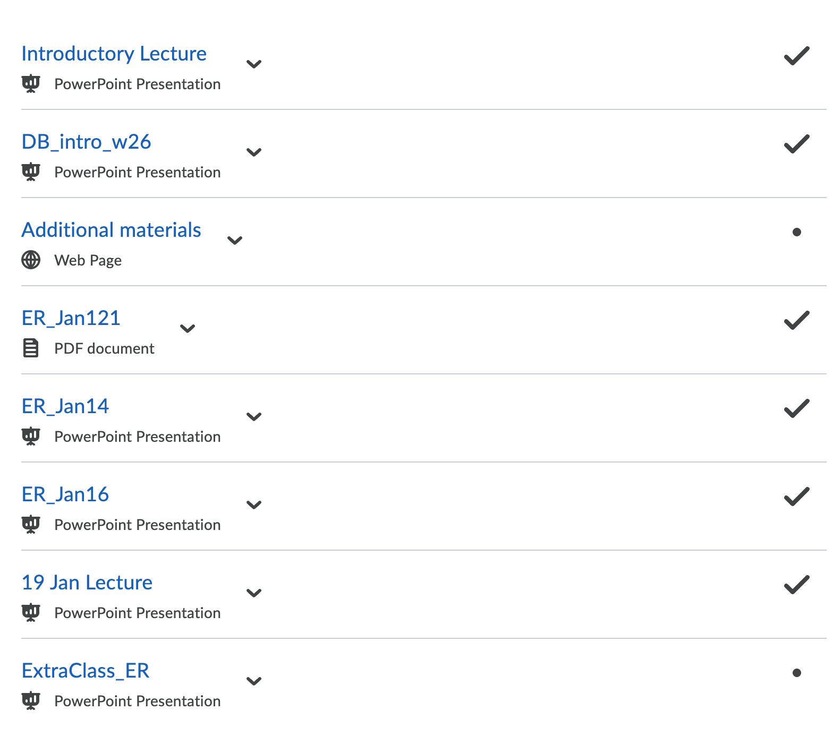
Tips
Make sure you review all slides

Slide 6
Tips
Make sure you practice all ER diagrams we did in the class
Identifying entities and attributes
Remember the shapes to define the entity, attributes, relationships
Practice all ER diagram related questions.

Slide 7
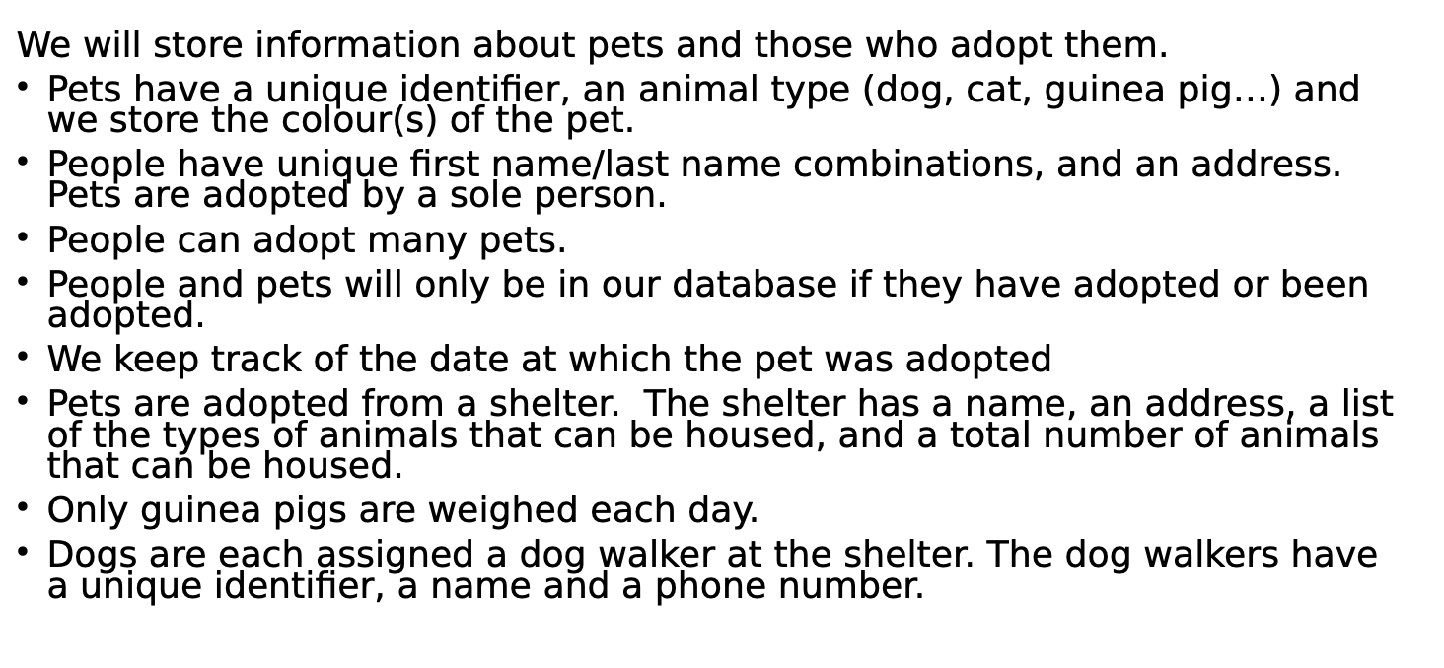
Sample question

Slide 8
DB Intro W26 lecture
Definitions
Types of data and their characteristics
Advantages of integrated DBMS
Life before DBMS
Different phases in DB design
3 schema DB architecture
Data independence
Practice book exercise as well

Slide 9
ER Jan9
ER model basics
Definitions, shapes
Different types of attributes, keys, cardinality constraints, participation constraints

Slide 10
ER Jan 14 and ER Jan16
Weak entities
Specializations
Practice ER diagrams

Slide 11
Extra class slide
Weak entity and participations
Solve ER question

